Slide 1
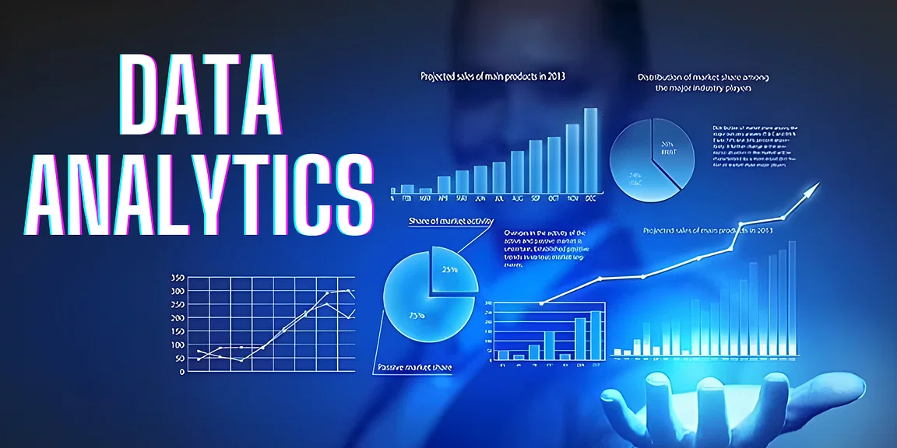

Slide 2
What is Data?
Data is a different types of information formatted in a particular manner or Data is a collection of information present in the form of History, Past records or Present records.
Data can come in the form of text, picture, numbers, graphs and symbols.
What is Data Analytics?
Data Analytics is the process of collection, transformation and organizing the data in order to draw conclusions, make predictions and to boost data driven decision making.

Slide 3
Applications of Data Analytics
Data Analytics is used in the banking and e-commerce industries to detect fraudulent transactions.
The Healthcare sectors uses data analytics to improve patients health by detecting diseases before they happen. It is commonly used for cancer detection.
Logistics companies use data analytics to ensure faster delivery of products by optimizing vehicle routes.
Marketing professionals use analytics to reach out to the right customers and perform targeted marketing to increase ROI.
Data analytics can be used for city planning, to build smart cities.

Slide 4
Diwali sales Data Analysis
Let me Explain how data analyst works in a real-world industry by taking example of Diwali Sales Data Analysis Project.
Steps Followed in Data analysis Process
Problem statement
Data Collection
Data Cleaning
EDA process
Creating Dashboard
Conclusion

Slide 5
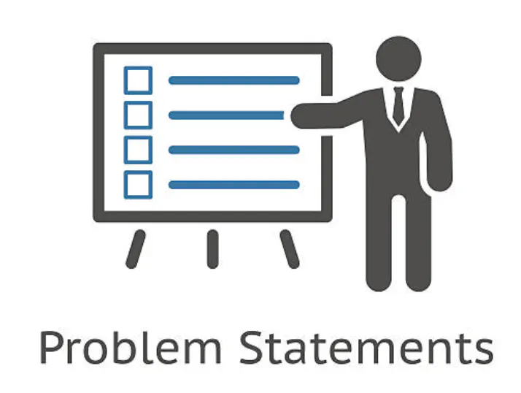
Step 1: Problem Statement
Find Number of the Total number of orders from top 10 States . Distribution of orders and amounts.Gender ,Age, Marital status distribution.

Slide 6
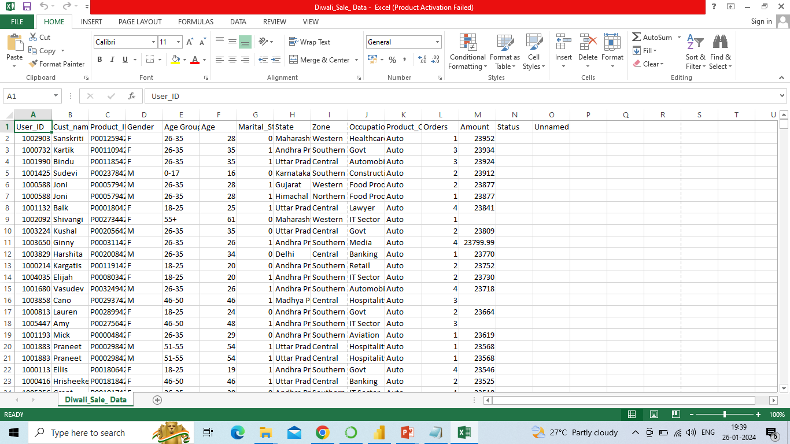
Step 2: Data Collection
Data Format: 'Diwali_Sale_ Data.csv’
Data Size: 1.3+ MB
Collection of measurements:
Total No. of Columns: 15
Total No. of Rows: 11250
Column Names:
Numerical Data/Columns:'User_ID', 'Age','Orders',’ Marital_Status’, 'Amount‘,’ Status’
Categorical Data/Columns: 'Cust_name‘, ’ Gender’, 'Age Group‘, 'Marital_Status', 'State’, 'Zone', 'Occupation', 'Product_Category‘, 'Product_ID’,

Slide 7
Step 3: Data Cleaning
Data cleaning process is done by using ETL (Extract, Transform, Load) technique.
Extract: Extract the data from file in csv, sql format of file.
Transform: Transform is nothing but modify or change the data. In this step we clean all the data, to find missing values and filled them using python libraries. So new values are added to the existed raw data and to make it clean.
Load: Load or upload the cleaned data into database.
Data cleaning is done by using Python in Jupyter Notebook
By using pandas library we accessed the data / read the file using following code:
df = pd.read_csv(‘'Diwali_Sale_Data.csv’)
Here df is a variable in which data is stored to perform operations, pd refers to pandas.

Slide 8
Using df.info() we check total numbers of columns and rows present in our dataset.
In this Diwali sales data we have total 15 columns and 11250 rows in which 15 columns have numeIn this column we have 175 rows of null values and in tenure column have 2 rows of null values.
We used Scikit-learn library to fill the missing values in the columns. Gender column containing only male & female so we used mode (most frequent) method to fill the null values. Considering rical data and remaining 1 is categorical data.
Created Plotting a bar chart for gender and it's count.
Created Plotting a bar chart for Gender Vs Total Amount and Age and Gender.
Created Plotting a bar chart total Amount Vs Age Group.
Crteated Plotting a bar chart Total number of orders from top 10 States.
Crteated Plotting a bar chart total Amount\Sales from top 10 state.
Crteated Plotting a bar chart for Marital Status vs Amount.
Crteated Plotting a bar chart Occupation, Product Categeory, Top 10 most sold products.

Slide 9
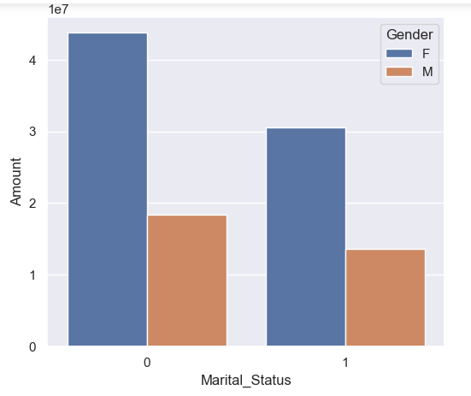
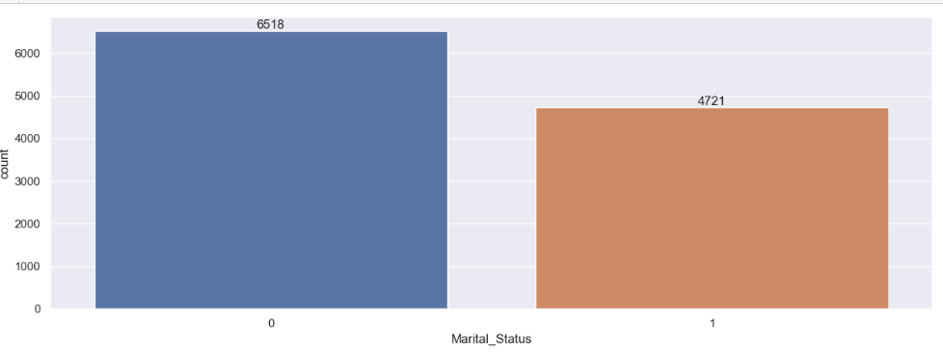
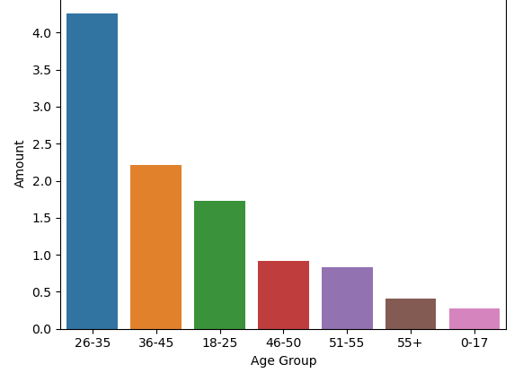
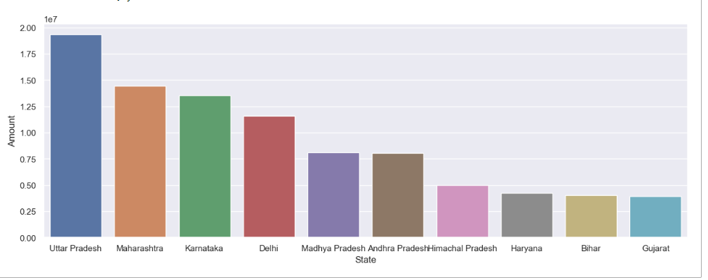
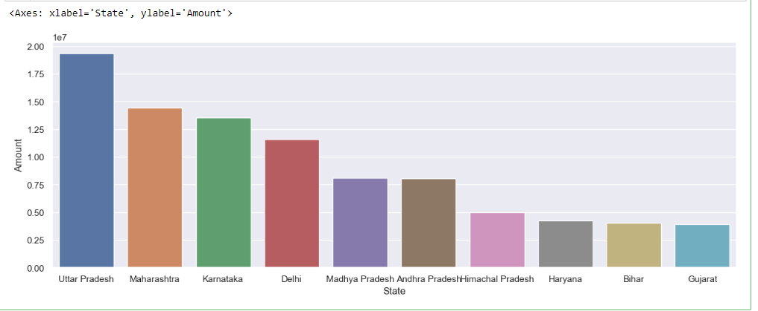
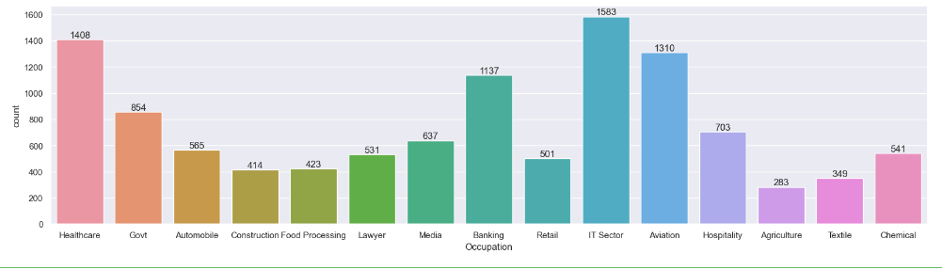
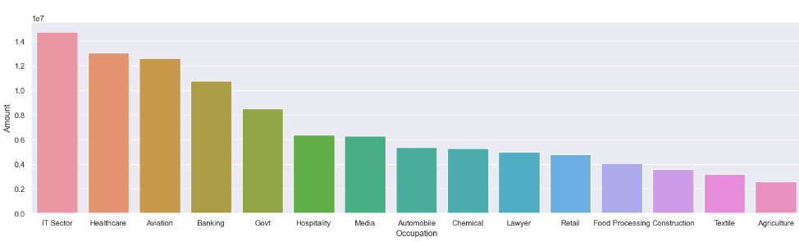

Slide 10
Conclusion:
Married women age group 26-35 years,Maharasta and Karnataka working on IT, Healthcare and Aviation are more likely to buy products from food ,clothing and Electronics Category.

